Slide 1

UE19CS353 – Object Oriented Analysis and Design with Java
Theory ISA (Mini Project)
Presentation on
AIRLINE RESERVATION SYSTEM
By:
MALAVIKA V PES2UG19CS212
MANASWINI RATHORE PES2UG19CS217
N R SAMHITHA RAO PES2UG19CS243
6th Semester D
PES University, Bengaluru
(Established under Karnataka Act 16 of 2013)
Department of Computer Science & Engineering
Session: Jan - May 2022

Slide 2
Object Oriented Analysis and Design with Java (Mini Project)
Project Description
This project aims to create an airline ticket reservation system. The system will include two variations, one for seat reservation for passengers and other for admin of the system.
Features of the passenger implementation:
They can mainly book flights based on different dates and times via reservation details and they can reserve any seat by looking at the seat reservation chart.
After the reservation, they fill in their personal details and proceed to the payment interface.
Once the payment is completed the customer will receive an online message and ticket through the email with all the information required regarding the flight.
Features of the Admin implementation:
They can manage all the flights by adding new flight plans, managing the seats in the plane,
Any changes they want to the system database through their interfaces
GitHub Link -https://github.com/manaswinirathore/OOADProject_Airline-Reservation-System.git

Slide 3
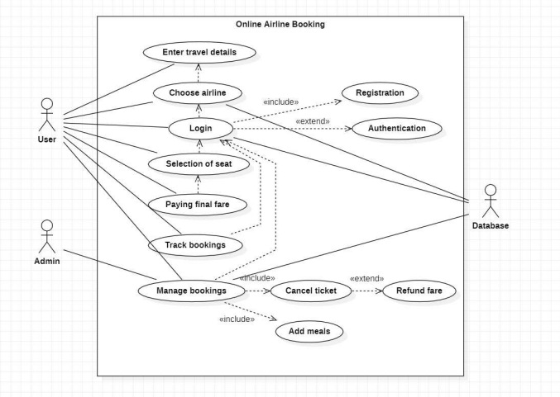
Object Oriented Analysis and Design with Java (Mini Project)
Analysis and Design Models
Use case diagram

Slide 4
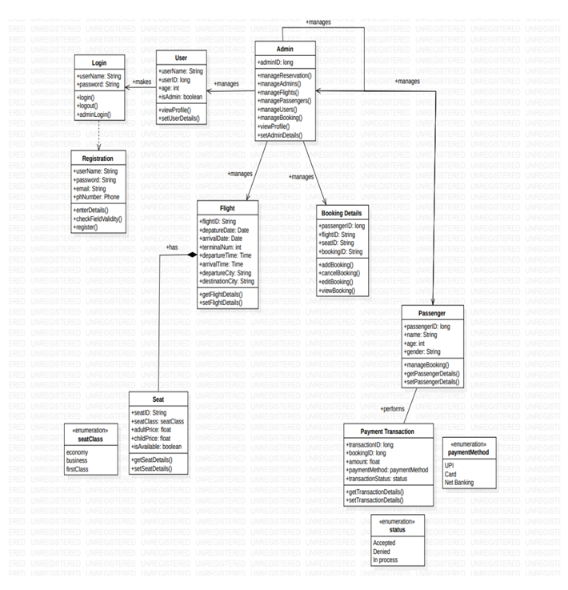
Object Oriented Analysis and Design with Java (Mini Project)
Analysis and Design Models
Class diagram

Slide 5
Object Oriented Analysis and Design with Java (Mini Project)
Tools and Frameworks Used
MySQL database
Spring Tool Suite
Spring Framework

Slide 6
Object Oriented Analysis and Design with Java (Mini Project)
Design Principle and Design Patterns Applied
Design principles:
Open-close principle
Design pattern:
DTO pattern : Data Transfer object- patterns which we call when we need to use such objects that encapsulate and aggregate data for transfer. They are objects that carry data between processes in order to reduce the number of methods calls. It is implemented in USerDto.java,PassengerDTO.java and FlightDto.java

Slide 7
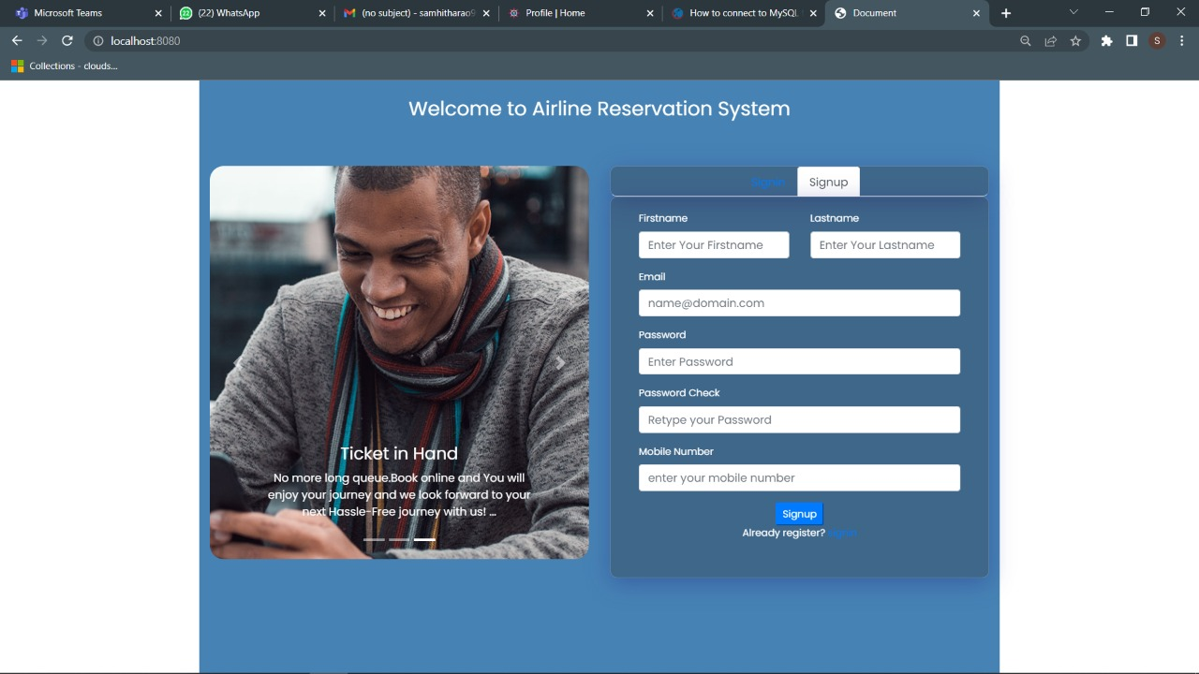
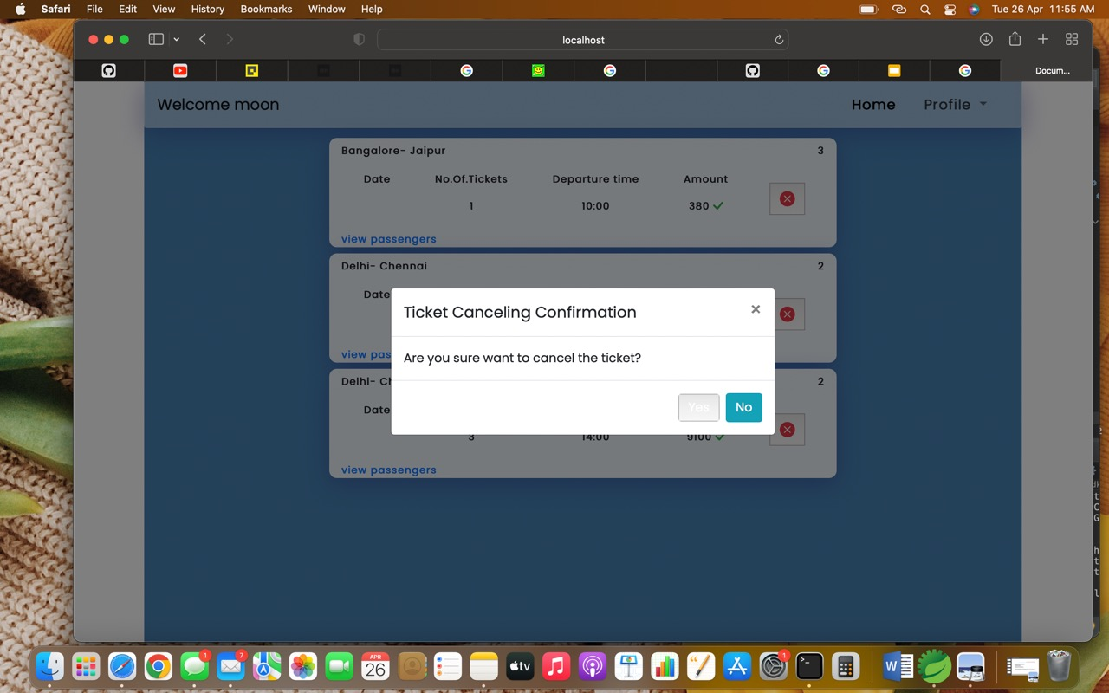
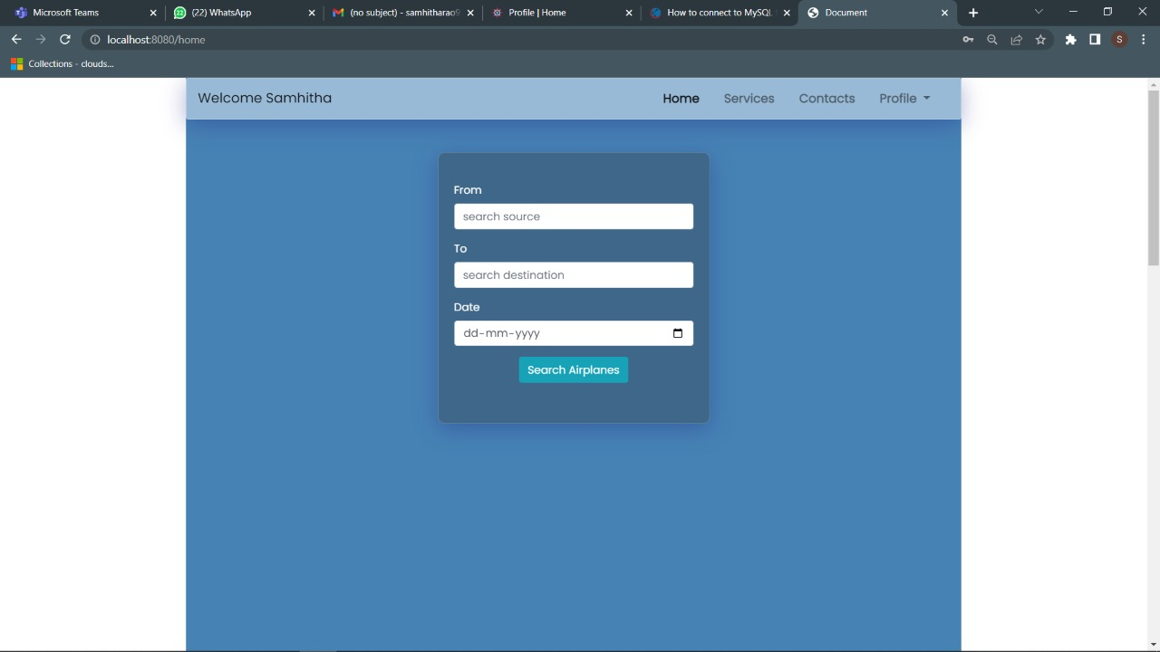
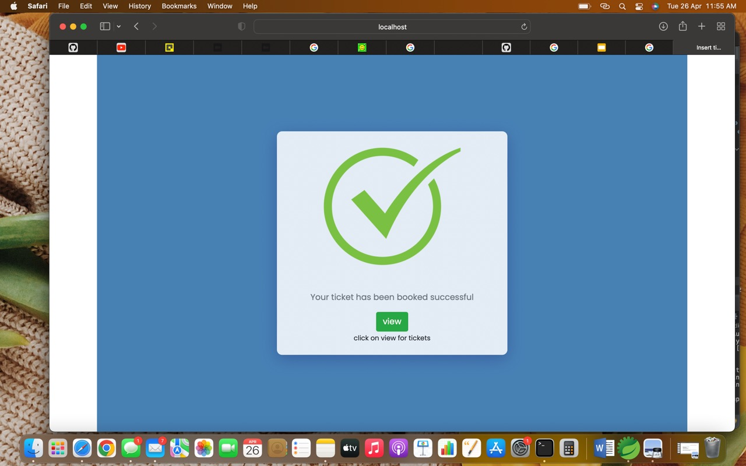
Object Oriented Analysis and Design with Java (Mini Project)
Screenshots

Slide 8
Object Oriented Analysis and Design with Java (Mini Project)
Team member contributions
Team member | Major features | Minor features
Malavika | Booking tickets | Selection of source and destination cities, seat selection, Date and timings
 | Managing bookings | Cancellation of tickets, payment interface
Samhitha | Home page: Site browsing | Choose airlines, Redirect/ Direct to home, contact us, services, profile page and logout
 | Tracking bookings | View flights
Manaswini | Admin level accessibility | Managing users and adding flights
 | User level accessibility | Login and registration of user and admin

